Slide 1
Employment Opportunities for Students with Disabilities

Slide 2
Overview
What Is The “Schedule A” Hiring Authority?
How Can I Be Considered Under “Schedule A?”
Eligibility and Qualifications
Documentation
Searching For Jobs
Applying For Jobs
Who Can Help Me Understand “Schedule A?”
How Is “Schedule A” Different From Other Hiring?
What Else Should I Know?
Where Can I Get More Information?

Slide 3
What is the “Schedule A” Hiring Authority?
Federal Government agencies want to hire people with different backgrounds that represent all of American society, including persons with disabilities
“Schedule A” refers to a special hiring authority (described in Government regulation) that gives Federal agencies an optional, and potentially quicker, way to hire persons with disabilities
People who apply under “Schedule A” follow specific steps that make it easier to apply for Federal jobs
Notes:
“Schedule A” refers to a specific section in Federal regulation that authorizes the use of this program.

Slide 4
How Can I Be Considered Under “Schedule A?” – Eligibility and Qualifications
You can apply for jobs using “Schedule A” if you are a person with a(n):
- Severe physical disability
- Psychiatric disability
- Intellectual disability
Make sure that you meet the eligibility and qualifications requirements of the job (with or without reasonable accommodation) – these will be described in the job posting

Slide 5
How Can I Be Considered Under “Schedule A?” – Documentation
You must provide documentation that shows “proof of a disability,” which is a letter that:
Specifically states that you are eligible to apply using “Schedule A” because you have an intellectual disability, severe physical disability, or psychiatric disability
DOES NOT need to detail your specific disability, medical history or need for reasonable accommodation
You should have your signed letter (on letterhead) before you apply under “Schedule A”
Notes:
NOTES:
The letter need not disclose the specific disability that makes them eligible for appointment. The letter must, however, clearly state that the applicant is qualified for appointment under this authority

Slide 6
How Can I Be Considered Under “Schedule A?” – Documentation (cont’d)
You can request this letter from a:
- Doctor
- Licensed medical professional
- Licensed vocational rehabilitation specialist, or
- Federal Agency, State/ U.S. Territory Agency, that issues or provides disability benefits
To find a vocational rehabilitation office in your area:
Go to the Job Accommodation Network at askjan.org
Select “Publications and Resources”
Under “Resources,” select “Federal, State, and Local Resources”
Select “Vocational Rehabilitation Agencies”
Go to https://www.opm.gov/policy-data-oversight/disability-employment/getting-a-job/sampleschedaletters.pdf to view a sample Schedule A letter

Slide 7
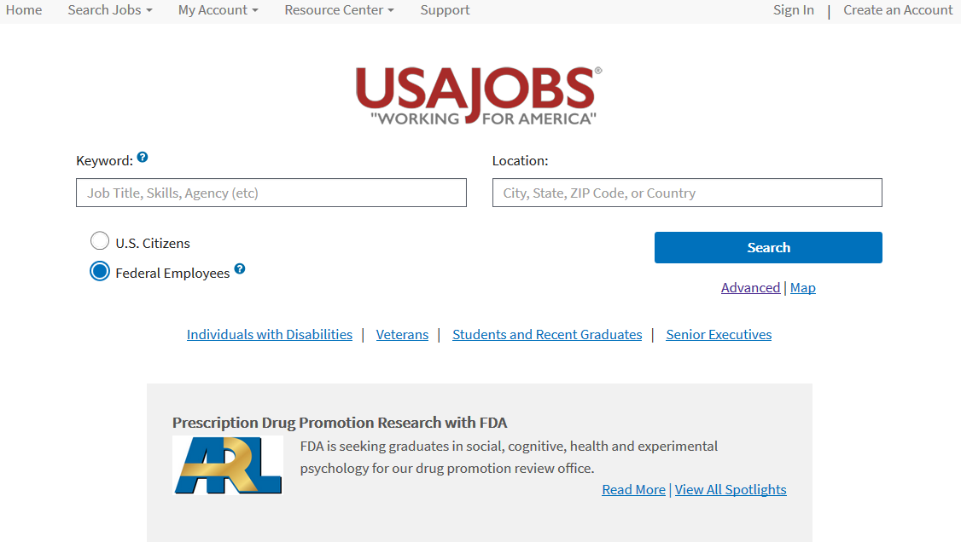
How Can I Be Considered Under “Schedule A?” – Searching for Jobs
This is the main landing page for USAJOBS. Here you can do a basic job search or select this link to learn more about applying for Federal jobs if you are an individual with a disability.

Slide 8
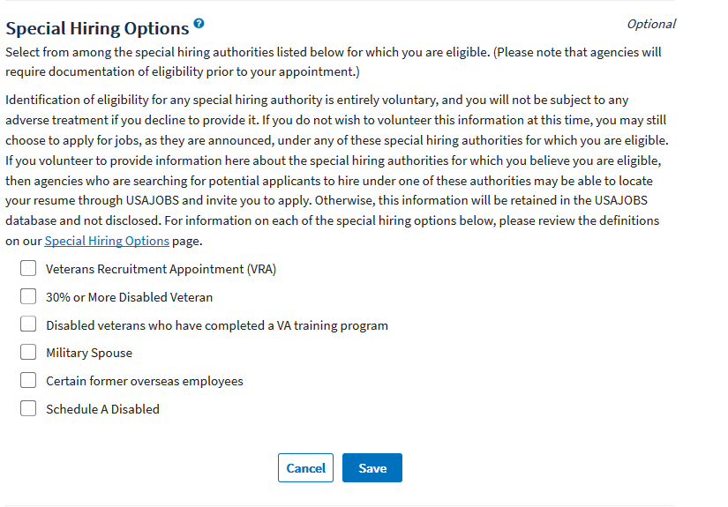
How Can I Be Considered Under “Schedule A?” – Searching for Jobs (cont’d)
When you set up your USAJOBS profile, check this box if you would like your résumé to be searchable by agencies when they try to find people who may be eligible to apply under “Schedule A.”

Slide 9
How Can I Be Considered Under “Schedule A?” – Searching for Jobs (cont’d)
You may see eligibility for “Schedule A” consideration in the “Who May Apply” section of the posting
Or you may see language such as the following in the “Job Summary” or other section of the job posting

Slide 10
How Can I Be Considered Under “Schedule A?” – Applying for Jobs
Find a job that interests you on USAJOBS at usajobs.gov
Make sure you meet eligibility and qualifications requirements for the job as detailed in the posting
Create a USAJOBS account in which you will:
Set up your Profile (indicate you are eligible for “Schedule A”)
Create your résumé by using the Résumé Builder or upload your own
Upload supporting documents (e.g., college/university transcripts). Ensure you submit all required documents or agencies will consider your application incomplete.
Notes:
NOTE: USAJOBS allows you to search for openings in a particular agency, career field, city or all three using the advanced search function.
USAJOBS allows you to save your job searches in the system once you create an account. You can also receive e-mail updates when new job announcements are posted which meet specific criteria saved on a USAJOBS account.

Slide 11
How Can I Be Considered Under “Schedule A?” – Applying for Jobs (cont’d)
Have your “Proof of a Disability” letter ready and include it as one of your uploaded documents
Apply for the job electronically through USAJOBS; or if allowed, directly with a Federal agency on their website
You may also ask for the help of a Federal agency’s Selective Placement Program Coordinator (may also be called a Disability Program Manager or Special Emphasis Program Manager)

Slide 12
How Can I Be Considered Under “Schedule A?” – Applying for Jobs (cont’d)
What Happens Next?:
Notification
Review of Eligibility and Qualifications
Interviews
Selection/Tentative Job Offer
Background Check/Security Clearance
Onboarding
Final Job Offer

Slide 13
Who Can Help Me Understand “Schedule A?”
Most Federal agencies have a Selective Placement Program Coordinator (SPPC) to help recruit, hire, and accommodate individuals with disabilities
Some agencies have a Disability Program Manager or Special Emphasis Program Manager to fulfill this function to help persons with disabilities
Not all agencies will have an SPPC or equivalent. In that case, speak with a Human Resources professional in the agency to get assistance with the Federal employment process
Notes:
Notes: Not all agencies have a DPM or SPPC, so you may need to speak with a human resources (HR) professional within the agency for help. If you are a veteran, you may want to contact a VA counselor.
Make sure when contacting the agency about Schedule A, you tell them you are referring to Schedule A for persons with disabilities.

Slide 14
Who Can Help Me Understand “Schedule A?”
SPPCs:
Provide information about Federal job opportunities
Guide job seekers through the application process
Answer questions about Federal employment and hiring
Help with requests for reasonable accommodation
Work with organizations involved in the placement of persons with disabilities and share information about Federal jobs
Facilitate the placement of applicants with disabilities
To find an agency SPPC:
Go to www.opm.gov and select the “Policy” tab
Under “Disability Employment,” select “Selective Placement Program Coordinator” and find the Directory

Slide 15
How Is “Schedule A” Different From Other Hiring? – Pathways Programs:
Pathways Programs
Internship Program
Recent Graduates Program
Presidential Management Fellows (PMF) Program
“Schedule A” applicants are given the same consideration as Pathways applicants

Slide 16
How Is “Schedule A” Different From Other Hiring? – Pathways Programs (cont’d):
Schedule A – Hiring Authority for People with Disabilities
Only for Individuals with Disabilities
Applicants who may be eligible for Schedule A can apply for Pathways positions, but not using Schedule A
Schedule D – Pathways Programs
Only for Students and Recent Graduates
Schedule A applicants are given the same consideration as Pathways applicants (i.e., they do not use Schedule A to apply for Pathways positions).
Notes:
Both paths lead to Federal employment but each provides a separate and distinct avenue into Federal employment, i.e., you can’t “mix and match” the two ways of hiring.

Slide 17
How Is “Schedule A” Different From Other Hiring? – 30% or More Disabled Veteran:
30 percent or More Disabled Veterans
Veterans with a disability rating of 30 percent or more who meet the qualification requirements for the position can be hired noncompetitively under a time-limited appointment lasting at least 60 days
The hiring manager may convert the veteran to a permanent competitive service position at any time during the time-limited appointment

Slide 18
What Else Should I Know? – Appointments
You can be appointed into Federal service in one of the following ways:
Permanent: not temporary or time-limited
Temporary: one year or less, with a specific expiration date
Term: more than one year but less than four years, with a specific expiration date
Notes:
NOTE: Permanent or time-limited employment options. An agency may make permanent or time-limited appointments where an applicant supplies proof of disability and the agency determines that the individual is likely to succeed in the performance of the duties of the position for which he or she is applying. In determining whether the individual is likely to succeed in performing the duties of the position, the agency may rely upon the applicant's employment, educational, or other relevant experience, including but not limited to service under another type of appointment in the competitive or excepted services
Temporary employment options. An agency may make a temporary appointment when:
(i) The agency determines that it is necessary to observe the applicant on the job to determine whether the applicant is able or ready to perform the duties of the position. When an agency uses this option to determine an individual's job readiness, the hiring agency may convert the individual to a permanent appointment in the excepted service whenever the agency determines the individual is able to perform the duties of the position; or
(ii) The work is of a temporary nature.
Time spent on a temporary appointment does not count towards the 2-year requirement.

Slide 19
What Else Should I Know? – Reasonable Accommodations
Federal agencies are required by law to provide reasonable accommodations to qualified applicants with disabilities, unless it would result in undue hardship to the agency
You can request a reasonable accommodation any time during the hiring process
Examples of reasonable accommodations during the hiring process include providing interpreters, readers, or other personal assistance

Slide 20
What Else Should I Know? – The Workforce Recruitment Program (WRP)
The Workforce Recruitment Program for College Students with Disabilities (WRP) is:
A recruitment and referral program that connects Federal and private sector employers nationwide with college students and recent graduates with disabilities
Managed by the Department of Labor, Office of Disability Employment Policy and the Department of Defense, Office of Management & Equal Employment

Slide 21
What Else Should I Know? – The Workforce Recruitment Program (WRP) (cont’d)
The WRP is an excellent way for students and recent graduates with disabilities in all fields of study to:
Market their abilities to a wide variety of potential employers across the United States
Sharpen their interviewing skills during a required phone interview with a WRP recruiter
Gain valuable skills, experience, and contacts on the job
For more information on the WRP, visit: https://wrp.gov/

Slide 22
Where Can I Get More Information?
USAJOBS https://help.usajobs.gov/index.php/Individuals_with_Disabilities
Schedule A video https://www.youtube.com/watch?v=gqRwI-6zCow
Disability Employment https://www.opm.gov/policy-data-oversight/disability-employment/
Workforce Recruitment Program https://wrp.gov/
Pathways Programs and Veteran Hiring Authorities https://hru.gov/Studio_Recruitment/HT_Hiring_Toolkit.aspx

Slide 23
Contact Us
Recruitment Policy and Outreach
U.S. Office of Personnel Management
outreach@opm.gov
(202) 606-0830
Disability Employment Office
DisabilityEmployment@opm.gov

